Slide 1
Biotechnology and
Post humanism

Slide 2
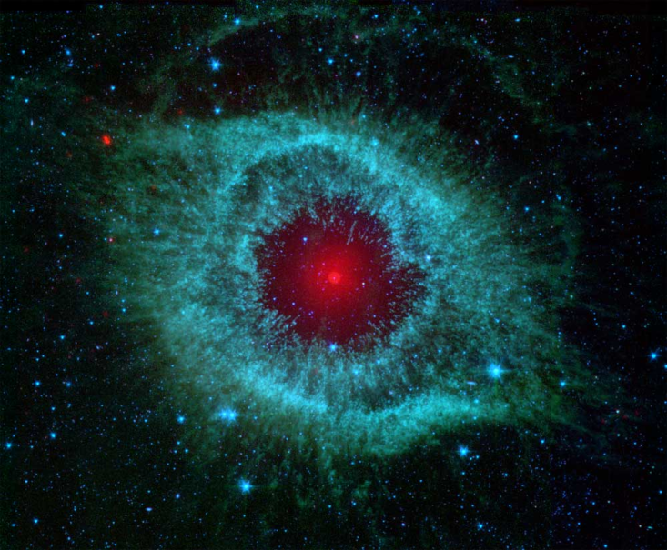
"Two things fill the mind
with ever new and increasing admiration and awe,
the more often and steadily we reflect upon them:
The starry heavens above me,
and the moral law within me”.
Immanuel Kant

Slide 3
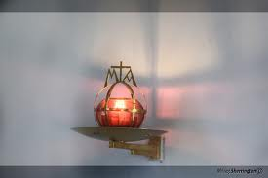
“What you are,
the way you live,
Affects others,
determines their misfortune or increases their happiness ”
Fr. J. Kentenich
Founder - International Schoenstatt Movement

Slide 4
Our frame of reference…
“Our ethical values
should not be founded
on myths, rumors or images, but in well
founded knowledge.”
Cañas Quirós

Slide 5
Biomedical research rests on a unique foundation of ethical responsibility – both to do no harm and to seek ways to alleviate human suffering.
Francis S Collins
NIH Director
Following Christ is thus the essential and primordial foundation
of Christian morality:
just as the people of Israel followed God who led them through the desert towards the Promised Land (cf. Ex 13:21)…
Pope JPII Veritatis Splendor 1993

Slide 6
How is it in Professional Life?
“ All professions are being challenged
by the very sad reality:
Doctors that exploit their patients,
Lawyers that dedicate their time
to criminal activities
Engineers and scientists that do not take into account the security
due to all people and the environment
and if we add to this
all the government corruption , all the violence …
The ethical theme touches the very core of our survival as a society.”
Dr. Rafael Cartagena (1983)

Slide 7
The Paradox of Our Time
We have taller buildings, but shorter tempers;
  wider freeways, but narrower viewpoints;
  we spend more, but have less;
  we buy more, but enjoy it less.
We have bigger houses and smaller families;
  more conveniences, but less time;
  we have more degrees, but less sense;
  more experts, but more problems;
  more medicine, but less wellness.

Slide 8
We have multiplied our possessions, but reduced our values.
We've been all the way to the moon and back, but have trouble crossing the street to meet the new neighbor.
We've cleaned up the air, but polluted the soul;
We have higher incomes, but lower morals;

Slide 9
These are times when we build more computers…( fanciers and smaller cell phones) but have less communication;
Times of fast foods and slow digestion;
Taller people, and weaker character
More kinds of food, but less nutrition.
Fancier houses, but more broken homes
We've become long on quantity, but short on quality.
We've conquered the outer space, but not our inner space
Authorship unknow

Slide 10
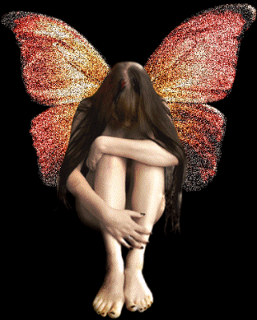
“One does not need to have much knowledge of the world or of humanity to realize clearly that our time with all its discoveries and research can not remove our inner emptiness. ” Fr. J. Kentenich
Pre-founding Document (1912)
How have we come to this situation?

Slide 11
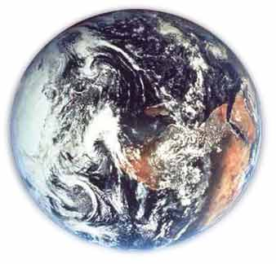
“All our attention, all our activities
have been exclusively directed
to the macrocosm, to the world at large,
to the world outside ourselves.”
JK
Pre-founding Document
1912

Slide 12
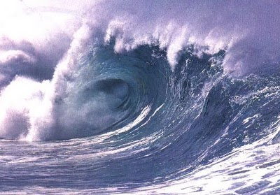
“ We do not hesitate to pay tribute to human genius that has conquered the mighty powers of nature, and taken them into his service.
We have spanned the distances of the world, explored the depths of the sea, penetrated mountains and flown through the heights…” JK
Pre-founding Document (1912)

Slide 13
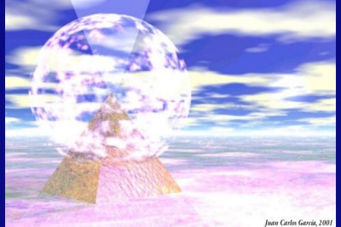

“There is a world, one that is eternally old and yet eternally new, the microcosm, the world in miniature.
Our own interior world, that remains unknown and unexplored.”
JK
Pre-founding Document (1912)

Slide 14
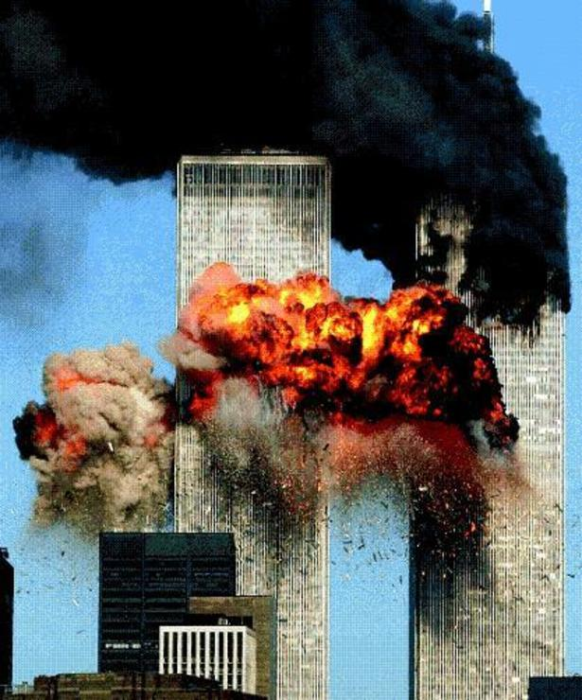
“An Italian statesman described once as the greatest danger of our modern times
that primitive and half civilized nations
would have access to modern technology
without receiving the intellectual and moral instructions enabling them to make correct use of these achievements”
JK
Pre-founding Document (1912)
9/11/2001

Slide 15
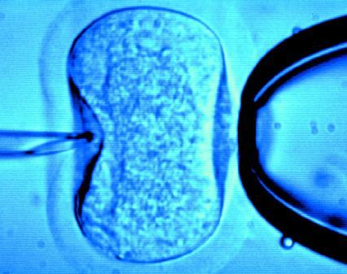
“ I would rather turn the tables and ask-
are our more developed
nations, able and mature
enough to make proper
use of the enormous
advances of our times?
Or is it more accurate to ask: has not our time become a slave to its achievements ? JK
-Pre-founding Document (1912)
In vitro Fertilization

Slide 16

Fiction or Reality ?
Reality:
“Saving Henry:
A Mother’s Journey”
Lauren Strogin
Fiction:
Is it fair to conceive a child so that parents can save their other child?

Slide 17
New challenges, new dilemmas
• Creation of the Embryo Adoption Programs
• Embryo Adoption was initiated in 2004 to give frozen embryos produced by IVF the opportunity to live
From January 2004 until April 2012, 1,820 transfers have been performed, giving place to
700 pregnancies and
550 born children,
104 other babies who are on their way
April 30th 2012

Slide 18
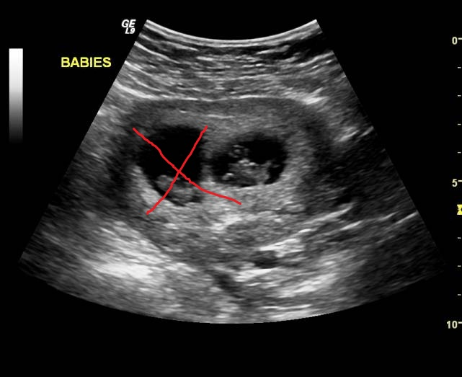
WHEN IVF GOES WRONG…
Women who are pregnant with twins
and only want one baby are seeking out the procedure...twin reduction.
Aug 2011

Slide 19
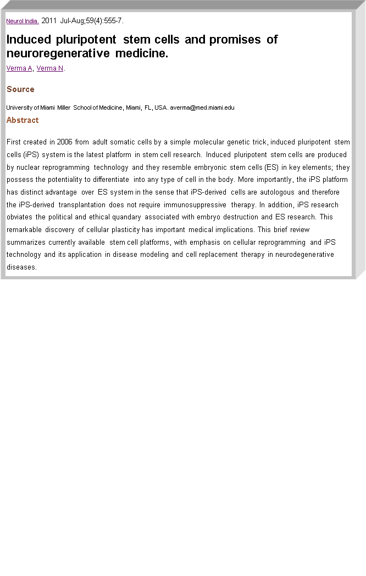
Reprogramming the Cell-Induced pluripotent stem cells (iPSCs)

Slide 20
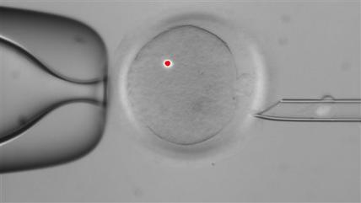
EUGENICS 2012:
ARE GENETICALLY ENGINEERED BABIES, A MORAL OBLIGATION?
DNA
genetically optimizing a sperm and egg
choosing the gender of the baby
screening out debilitating diseases
  Oregon scientists make embryos with 2 women, 1 man- Oct 24, 2012

Slide 21
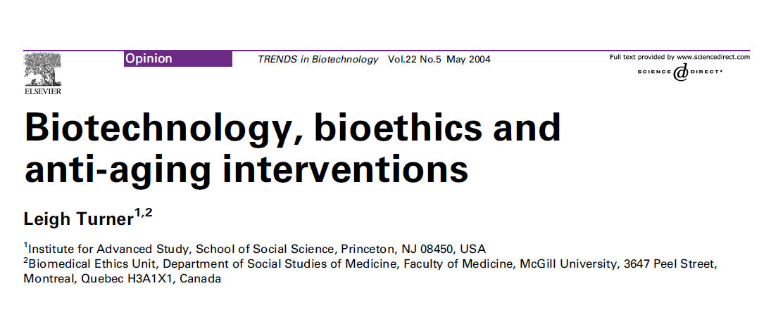
IS IT POSSIBLE THAT SCIENCE WILL GIVE US ETERNAL LIFE ?

Slide 22
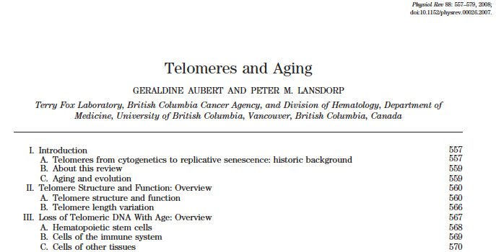
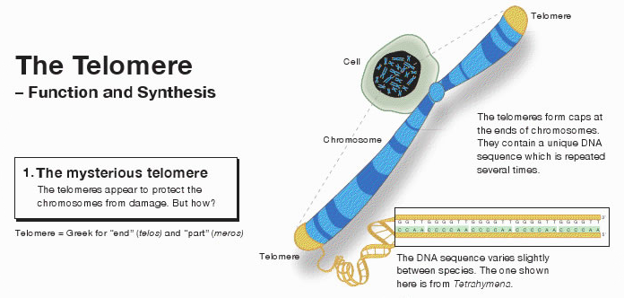
ARE TELOMERES THE KEY ?

Slide 23

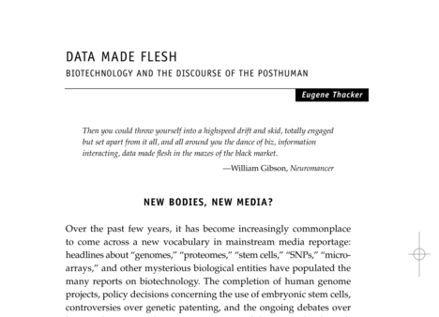
OUR POST HUMAN FUTURE: CONSEQUENCES OF THE BIOTECHNOLOGY REVOLUTION

Slide 24
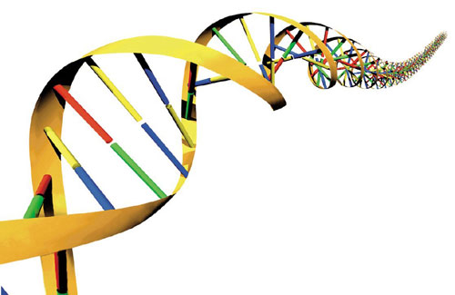
What has happened?
“Our command of the gifts and powers of nature has not gone hand in hand with the control of the instintive and animal forces in our own heart”
“Instead of becoming masters of our achievements we have become their slaves.”
JK
Pre-founding Document (1912)

Slide 25
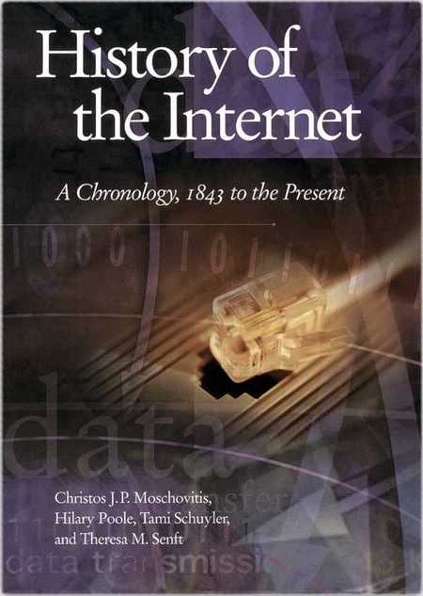
“We have to decide!
We go either forward or backwards!
Should we go backwards to the middle ages?
  Return the electricity to the clouds,
  The coal to the earth?
  Close the universities?
  Cut the telephone lines?
  No! Never!
  JK
  Prefounding Document (1912)
Cut the Internet
cables?

Slide 26
What can be done?
“Therefore Forward!
This should be the call:
  The greater the exterior progress
  the greater the deepening of our inner life.
  - Let us go forward in conquering the sciences
  without abandoning the conquest of our inner world.” JK
  Pre-founding Document (1912)

Slide 27
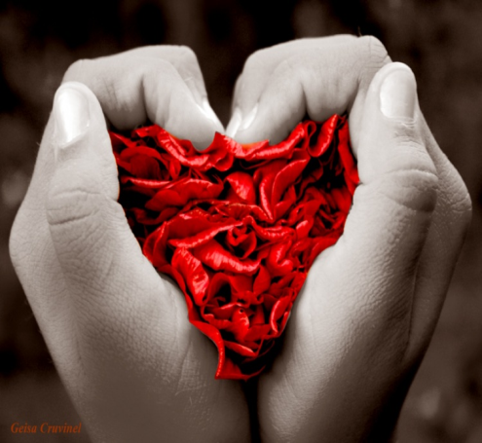
But how?
“In the future we can no longer allow ourselves to be ruled by our knowledge, WE must rule our knowledge.
It should not happen that we know foreign languages, but remain ignorant
in the understanding
of the language of our
own hearts.” JK
Pre-founding Document (1912)

Slide 28

“ The degree of our growth in knowledge must be the degree of our growth in inner depth, in our spiritual development.
Otherwise an immense emptiness will come about in our soul, a huge abyss that will make us deeply unhappy ”JK
Prefounding Document (1912)

Slide 29
Therefore, Self-education!
Know yourself!
Look for a healthy balance!
The balance between your faith and your grasp of science will answer the needs and most profound wishes
  of your hearts
  you will be making an important contribution to solving the needs and meeting the challenges of our times

Slide 30
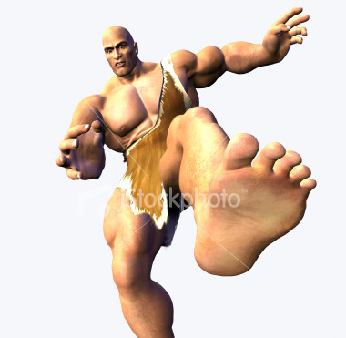
the need of self education
“The digital world is in need of
self education lest we be crushed
by giants who want to rob us of
our memories and our
independent thinking.
Since we will never return to the pre-digital age we need people who see through the system and master things the computer can not do”.
Frank Shirrmacher

Slide 31
Accept the challenge of self education
An invitation to
-face up to the imperatives of life
-mobilize an integrated formation of the personality
-not only focus on self realization
-focus also on the responsibility
for others

Slide 32
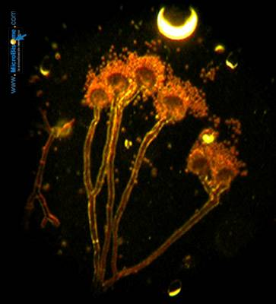
“ We need great women and men of God that become great researchers, as much of the truths of our faith as in science.”
“Ethics will help genetics (research) avoid the nightmare of Eugenetics.”
Pope Benedict XVI

Slide 33
“Donum vitae”
“Science must always be united to wisdom. Science and technology can be replaced, because each day they try to go beyond their own frontiers. It is wisdom and a formed concience that will set the limits…”
Pope John Paul II
Documents of the Catholic Church

Slide 34

The Pillars of Wisdom
(The Profile of a Scientist for the 21st Century)
Prudence
  Not all that can be done, should be done
Knowledge
  Learn what is the ethical thing to do
  What does my Faith say about this?
  “I am the Way, the Truth and the Life.”
Discretion
  Think, observe, analyze, act

Slide 35
Counsel
  You are not alone! Ask for guidance!
  Be firm! Not like a streamer or kite, that goes where the wind blows.
  Make free decisions and carry them out !
Understanding
  Apply your knowledge. Integrate your faith and your life.
Power
  You have been given many talents. You have the ability to learn , to do wonderful things, to make decisions, to serve, to love.

Slide 36
Final blessing

Slide 37
"May God bless you with discomfort
at easy answers, half truths, and superficial relationships,
so that you may live deep within your heart.
"May God bless you with anger
at injustice, oppression, and exploitation of people,
so that you may work
for justice, freedom and peace.
Notes:
Quoted by Dr. Francis S. Collins, M.D., Ph.D NIH Director at his ’ Acceptance Speech at the
Pro Bono Humanum Award of the Galien Foundation
OCTOBER 16, 2012 – NEW YORK CITY

Slide 38
"May God bless you with tears
to shed for those who suffer from pain, rejection, starvation and war,
so that you may reach out your hand
to comfort them and
to turn their pain into joy.
And may God bless you with enough foolishness
to believe that you can make
a difference in this world,
so that you can do what others claim
cannot be done.”
Sister Ruth Fox, OSB (1985)
Notes:
Sister Ruth Fox, OSB (1985)
a Benedictine nun

Slide 39
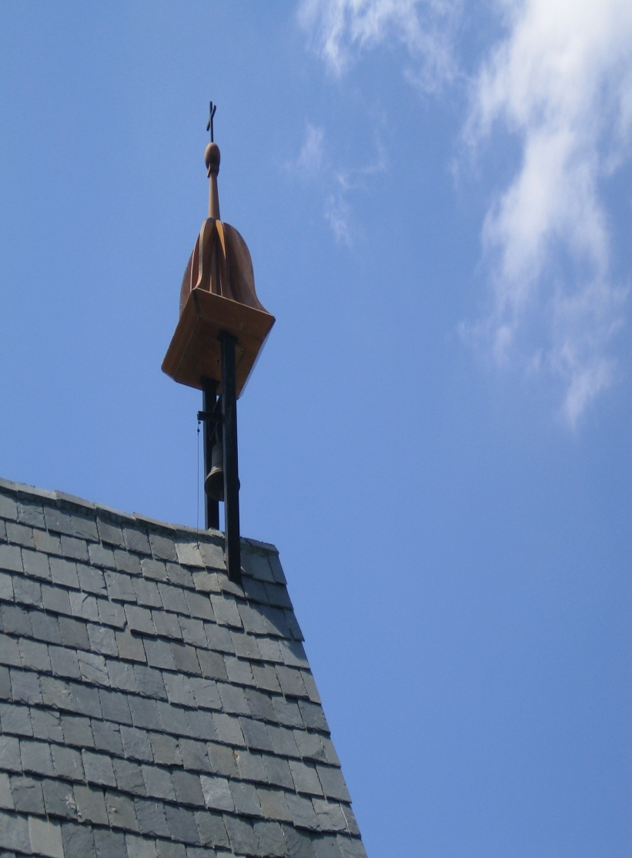
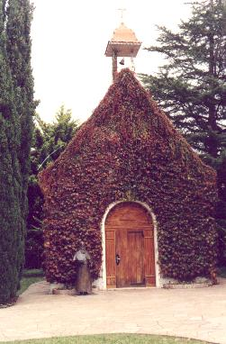
“Holy is this place
And many saintly people will continue to be formed and educated from this place”
J.K.

